Slide 1


Data Structure
Dr Shahjad
Faculty
School of Engineering & Technology
K.R. Mangalam University
Unit 3 : Sorting and Searching

Slide 2


Key Learning Outcomes
Understand the importance of data organization
Analyze data sets to determine the most suitable algorithm
for a given scenario.
Compare and contrast the efficiency and effectiveness of
different searching and sorting algorithms.
Identify opportunities for optimization or improvement in
existing algorithms.

Slide 3
INTRODUCTION TO SORTING
Session 32
Basic Introduction of Sorting
Applications of Sorting in Real World
Bubble Sort
Algorithm and Complexity Analysis of Bubble
Sorts
Brainstorming Session

Slide 4
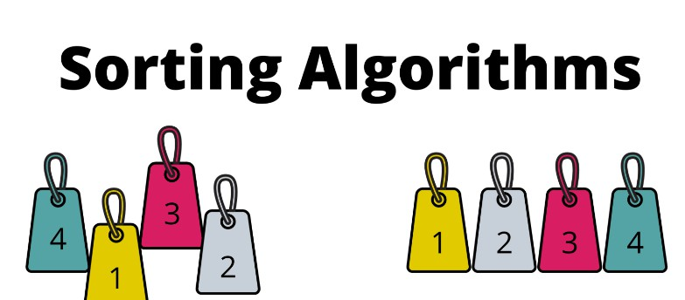
Basic Introduction of Sorting
rearrange elements of our data on basis of increasing/decreasing order to perform our key operation.
This process of rearrangement is called Sorting.
Sorting data allows a user to find information faster and easier.

Slide 5

Types of Sorting
The Sorting techniques can be divided into two categories
Comparison based Sorting: determine the order of elements by comparing pairs of elements.
The sorting decisions are based solely on these comparisons.
Non Compariosn based Sorting : They do not rely on element comparisons to determine order.
Instead, they leverage properties of the input data, often achieving linear or near- linear time complexity under certain conditions.

Slide 6
Applications of Sorting in Computer Science
Database Management: Sorting is crucial for efficient querying
and indexing in databases.
Machine Learning: Sorting is used in preprocessing steps for
feature scaling and normalization.
Parallel Computing: Sorting algorithms are fundamental in
parallel computing for tasks like load balancing and task
scheduling

Slide 7
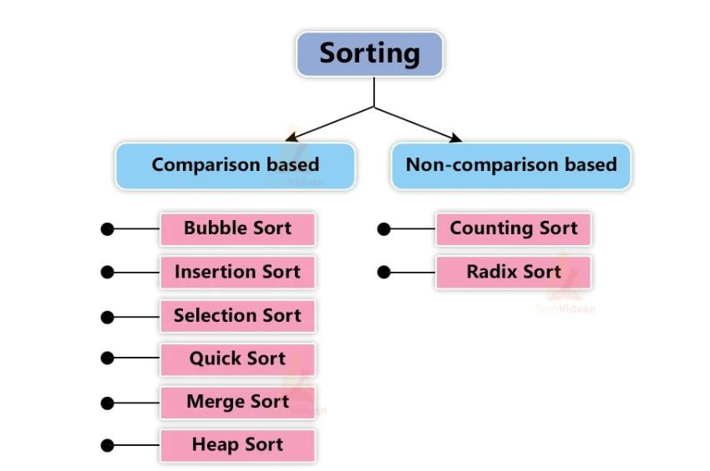
Types of Sorting
Source : https://techvidvan.com/tutorials/wp- content/uploads/sites/2/2021/06/TechVidvan-Bubble-sort- normal-image01.jpg.

Slide 8
Bubble Sort
It repeatedly swapping the adjacent elements if they are in wrong order.
This algorithm is suitable for small data sets
It is known as bubble sort, because with every complete iteration
the largest element bubbles up towards the last place or the
highest index just like a water bubble rises up to the water surface.

Slide 9
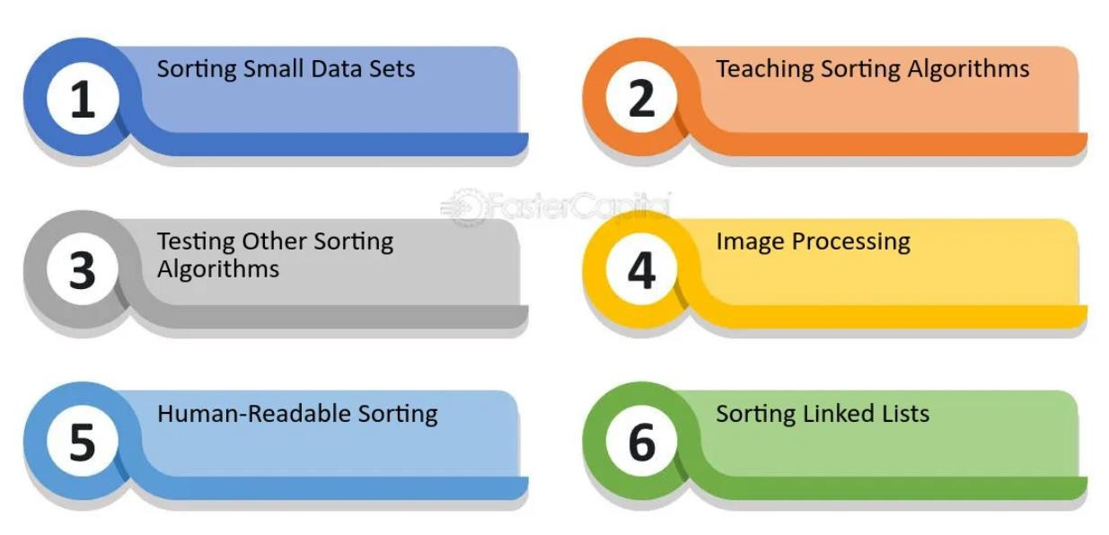
Real World Application of Bubble Sort

Slide 10
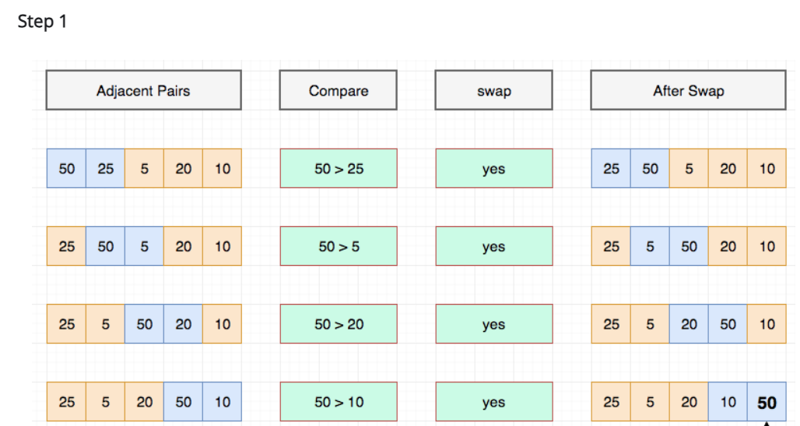
Example of Bubble Sort
Let's take an array of 5 elements. int arr[5] = {50, 25, 5, 20, 10}

Slide 11
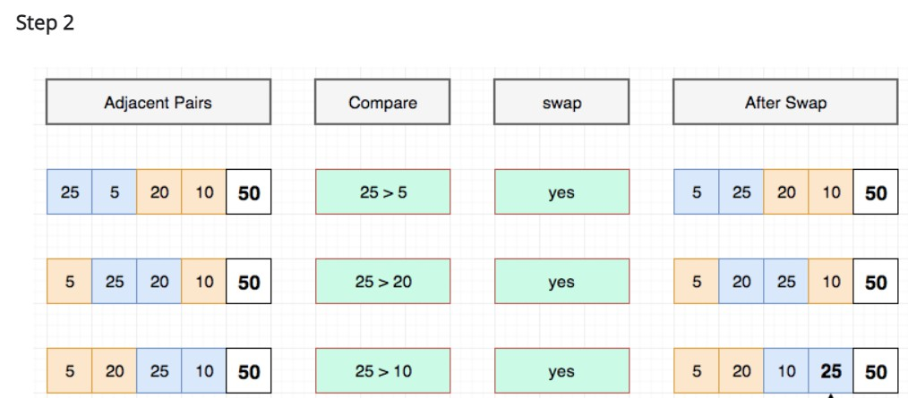
Cont..

Slide 12
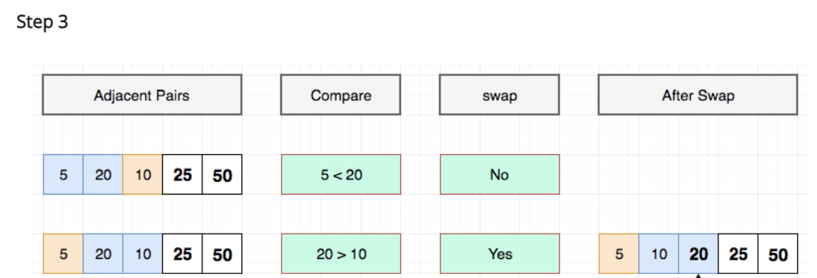
Cont..

Slide 13
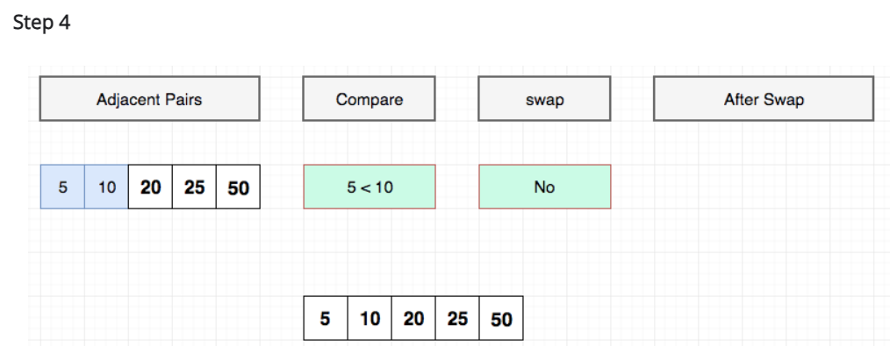
Cont..

Slide 14
Test Your knowledge
1. How many passes are required to sort an array of n elements using Bubble Sort?
A. n B. n – 1 C. log n D. n²
2. Bubble Sort is an example of which type of algorithm?
A. Divide and conquer B. Greedy C. Brute force D. Comparison-based

Slide 15
Test Your knowledge
3. Which of the following is true for Bubble Sort?
A. It is stable and in-place B. It is unstable but in-place C. It is stable but not in-place D. It is neither stable nor in-place

Slide 16
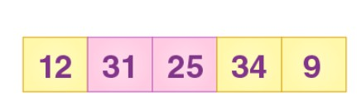
Test Your knowledge
Question: Sort the following Array using Bubble Sort

Slide 17
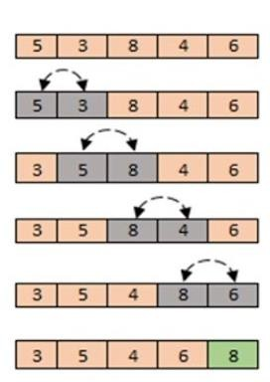
Bubble Sort Algorithm
declare variables i, j
loop : i = 0 to n – 1 // outer loop
loop : j = 0 to n -i- 1 // inner loop
if ( a[j]>a[j+1] ) then
– swap a[j] & a[j+1]
end loop // inner loop
end loop // outer loop

Slide 18
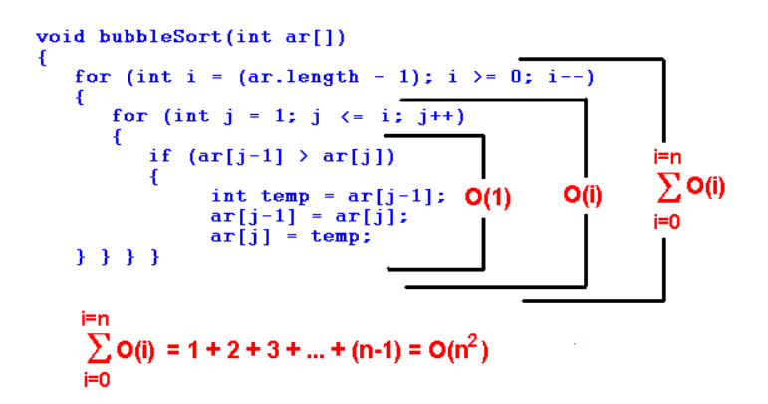
Bubble Sort Algorithm Complexity Analysis

Slide 19
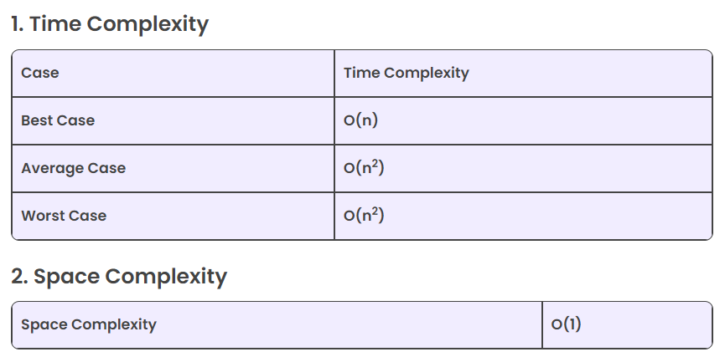
Bubble Sort Algorithm Complexity Analysis

Slide 20
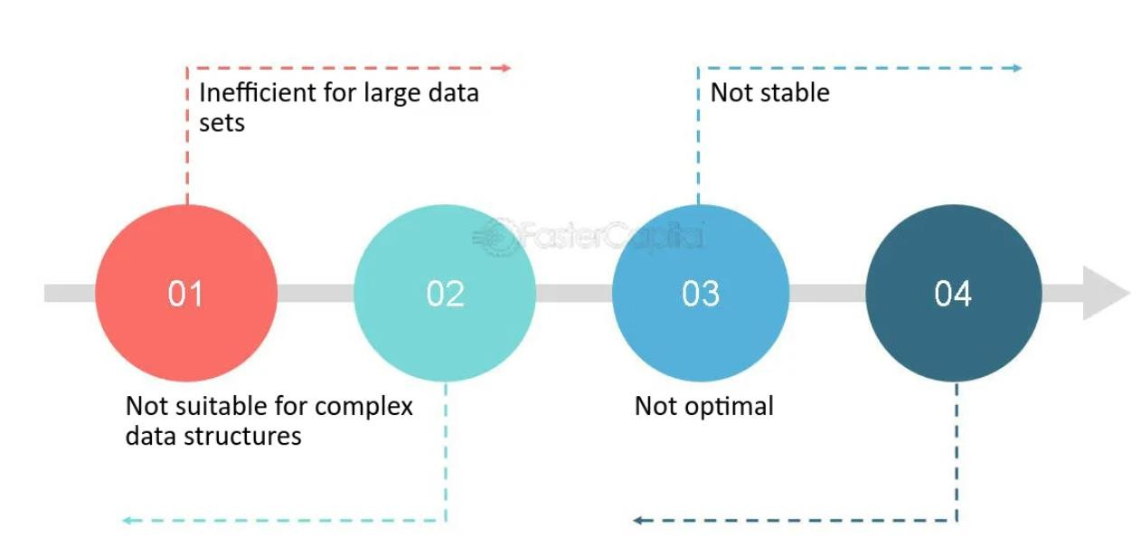
Advantages & Disadvantages

Slide 21
Test Your Knowledge
Q1 Which of the following sorting algorithms performs poorly on large datasets?
Bubble Sort
Quick Sort
Merge Sort
Heap Sort
Answer (A)
Q2 What will be the recurrence relation of the code of recursive bubble sort?
T(n) = 2T(n/2) + n
T(n) = 2T(n/2) + c
T(n) = T(n-1) + n
T(n) = T(n-1) + c
Answer (C)

Slide 22
REVIEW
Sorting data allows a user to find information faster and easier.
Bubble Sort is the simplest sorting algorithm that works by repeatedly swapping the adjacent elements if they are in wrong order.

Slide 23
References
https://www.hackerearth.com/practice/algorithms/sorting/bubble-sort/tutorial/
https://www.freecodecamp.org/news/most-asked-questions-about-bubble-sort/
https://www.scholarhat.com/tutorial/datastructures/bubble-sort-in-data-structures
https://www.scaler.com/topics/data-structures/bubble-sort/
https://visualgo.net/en/sorting
https://www.youtube.com/watch?v=9I2oOAr2okY
Dr. Swati, Ms Suman & Ms Neetu

Slide 24

THANK YOU

